Slide 1
IBM Watson Studio from wild idea to AI app

Slide 2
Wendy Switzer
Sarah Packowski
IBM Watson Studio Content Design

Slide 3
Recording

Slide 4
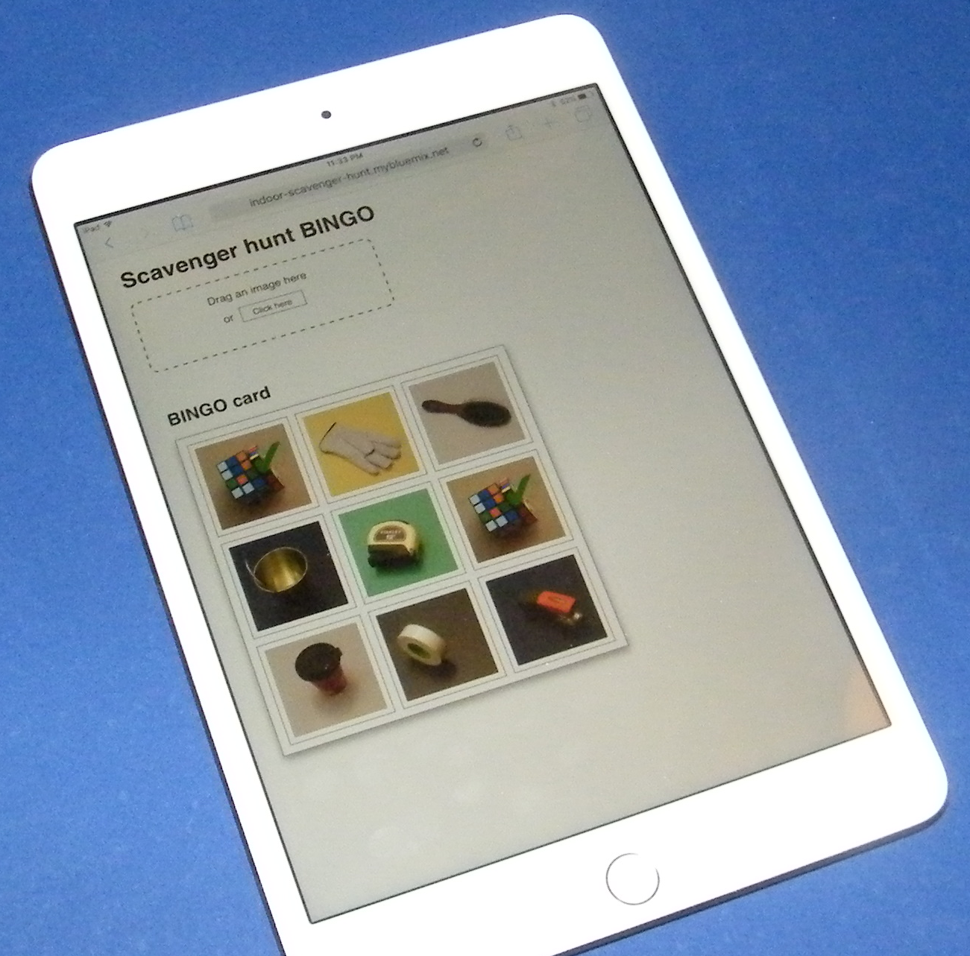
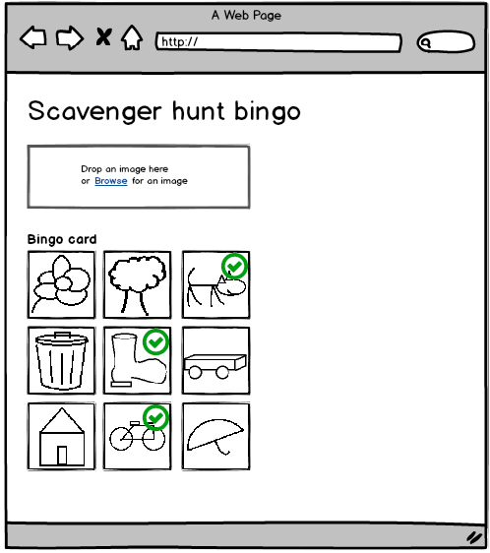
User Experience Feedback Session Not just a presentation. A conversation.
Scenario
You have a wild idea for an AI solution that you want to demo or test
Phases
Collect training data
Build a model
Test your idea in an app
Example
Scavenger hunt BINGO

Slide 5
Before we begin…
Our goal: Learn from you
What are your favorite tools/features, and why do you like them?
What do you want to see in Watson Studio?
What do you like/dislike in Watson Studio?
Your goals
Why did you decide to attend this session?
What do you hope to get out of this session?

Slide 6
Phase 1: I have a wild idea, but no data to train a model!

Slide 7
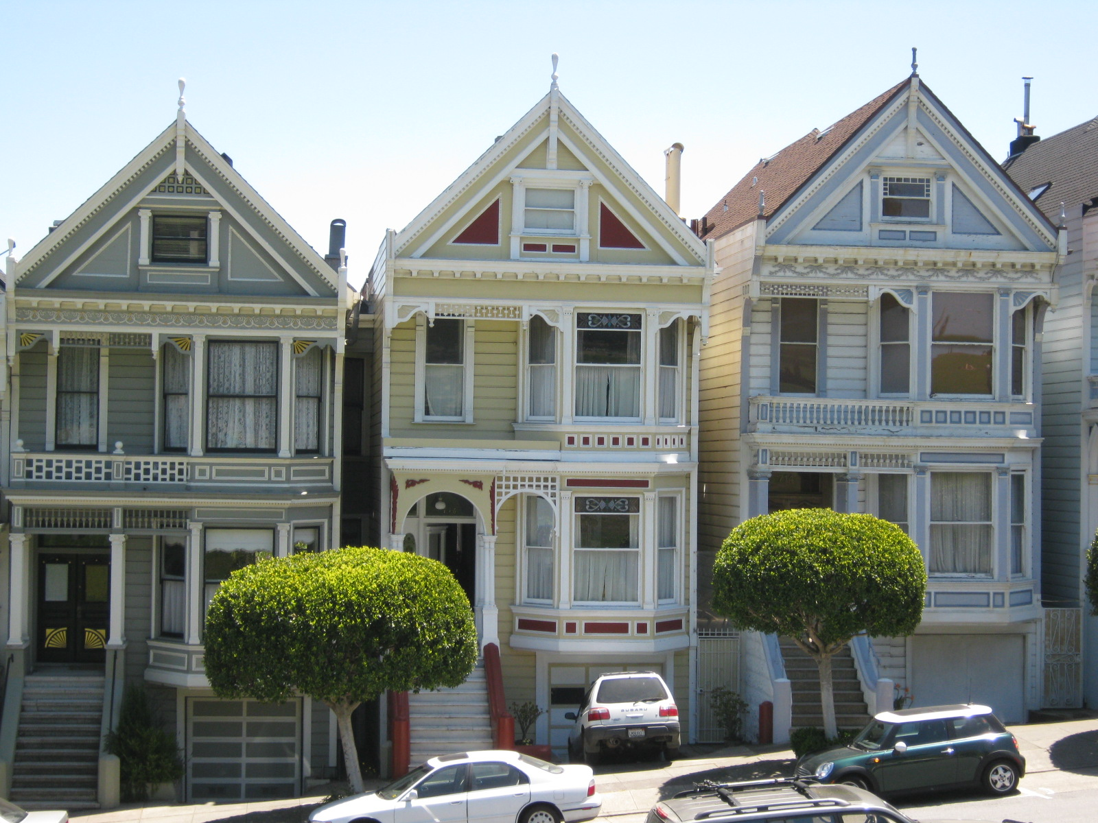

We wanted to create a scavenger hunt application for tourist spots in San Francisco…

Slide 8

But we live in Canada!

Slide 9
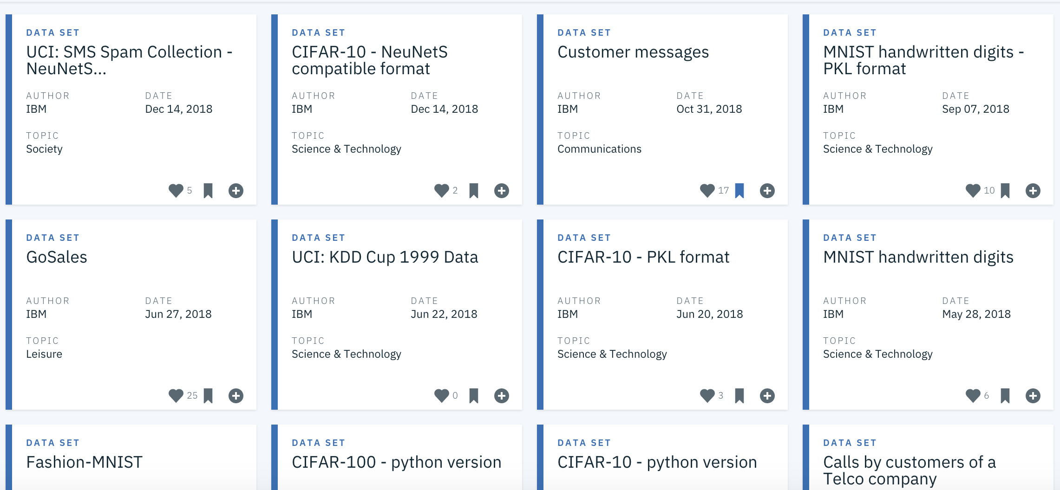
Data sets Community in Watson Studio

Slide 10
When have you needed training data?
Where did you look?
How did you search?
What format did you need?
What worked well?
Sites with great resources
Searches that worked well

Slide 11
What problems have you had with using open data?
Noise
No good labeling
Terms of use unclear

Slide 12
We used freely available photos of tourist spots in San Francisco…

Slide 13
Phase 2: Now I want to train and test a model

Slide 14
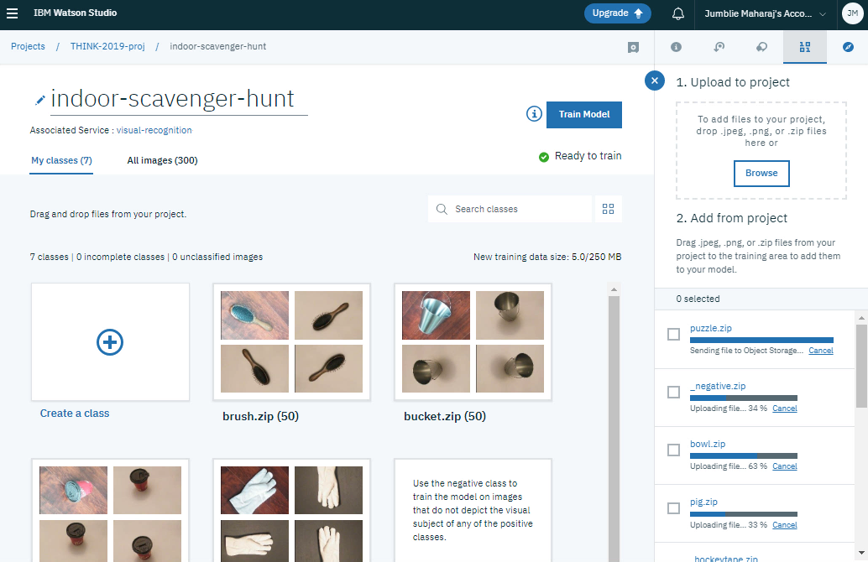
DEMO Visual Recognition model builder in Watson Studio

Slide 15
Building a model
What tools to you use?
What do you like about those tools?
What would you like to see in Watson Studio?
What kind of models do you want to rapidly prototype?

Slide 16
Phase 3: Now I want to prototype / demo my idea

Slide 17
We wanted to create a scavenger hung BINGO game…

Slide 18
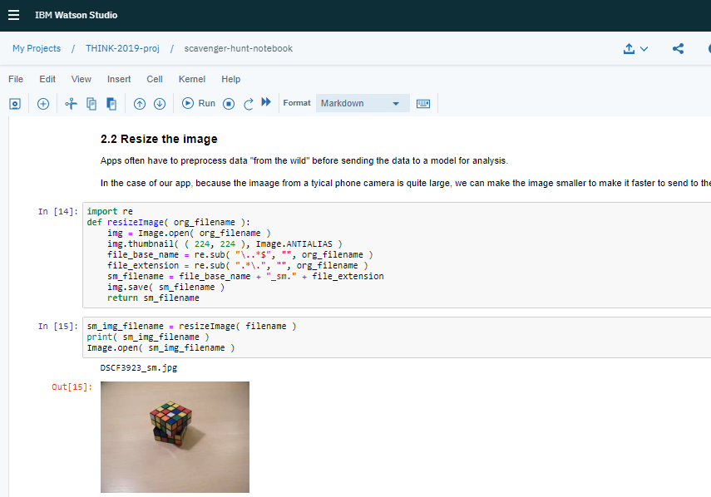
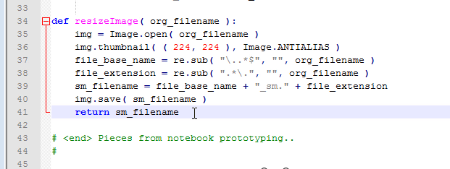
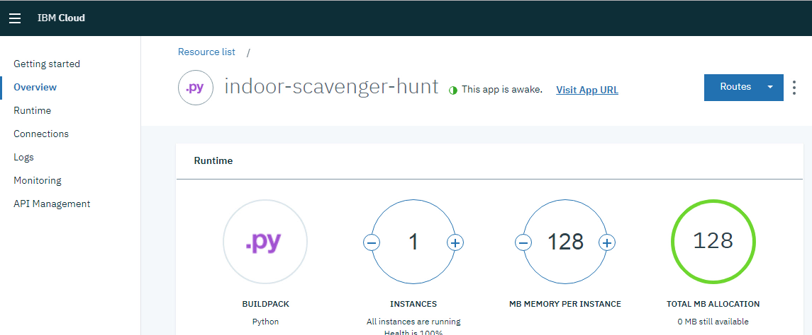
DEMO Notebook in Watson Studio Web app in IBM Cloud

Slide 19
Building an app
What tools to you use prototype or build apps?
What do you like about those tools?
What would you like to see in Watson Studio?
Where do you host your apps? How do you get them there?

Slide 20
Please note
IBM’s statements regarding its plans, directions, and intent are subject to change or withdrawal without notice and at IBM’s sole discretion.
Information regarding potential future products is intended to outline our general product direction and it should not be relied on in making a purchasing decision.
The information mentioned regarding potential future products is not a commitment, promise, or legal obligation to deliver any material, code or functionality. Information about potential future products may not be incorporated into any contract.
The development, release, and timing of any future features or functionality described for our products remains at our sole discretion.
Performance is based on measurements and projections using standard IBM benchmarks in a controlled environment. The actual throughput or performance that any user will experience will vary depending upon many factors, including considerations such as the amount of multiprogramming in the user’s job stream, the I/O configuration, the storage configuration, and the workload processed. Therefore, no assurance can be given that an individual user will achieve results similar to those stated here.

Slide 21
Notices and disclaimers
© 2018 International Business Machines Corporation. No part of this document may be reproduced or transmitted in any form without written permission from IBM.
U.S. Government Users Restricted Rights — use, duplication or disclosure restricted by GSA ADP Schedule Contract with IBM.
Information in these presentations (including information relating to products that have not yet been announced by IBM) has been reviewed for accuracy as of the date of initial publication and could include unintentional technical or typographical errors. IBM shall have no responsibility to update this information. This document is distributed “as is” without any warranty, either express or implied. In no event, shall IBM be liable for any damage arising from the use of this information, including but not limited to, loss of data, business interruption, loss of profit or loss of opportunity. IBM products and services are warranted per the terms and conditions of the agreements under which they are provided.
IBM products are manufactured from new parts or new and used parts. In some cases, a product may not be new and may have been previously installed. Regardless, our warranty terms apply.”
Any statements regarding IBM's future direction, intent or product plans are subject to change or withdrawal without notice.
Performance data contained herein was generally obtained in a controlled, isolated environments. Customer examples are presented as illustrations of how those customers have used IBM products and the results they may have achieved. Actual performance, cost, savings or other results in other operating environments may vary.
References in this document to IBM products, programs, or services does not imply that IBM intends to make such products, programs or services available in all countries in which IBM operates or does business.
Workshops, sessions and associated materials may have been prepared by independent session speakers, and do not necessarily reflect the views of IBM. All materials and discussions are provided for informational purposes only, and are neither intended to, nor shall constitute legal or other guidance or advice to any individual participant or their specific situation.
It is the customer’s responsibility to insure its own compliance with legal requirements and to obtain advice of competent legal counsel as to the identification and interpretation of any relevant laws and regulatory requirements that may affect the customer’s business and any actions the customer may need to take to comply with such laws. IBM does not provide legal advice or represent or warrant that its services or products will ensure that the customer follows any law.

Slide 22
Notices and disclaimers continued
Information concerning non-IBM products was obtained from the suppliers of those products, their published announcements or other publicly available sources. IBM has not tested those products about this publication and cannot confirm the accuracy of performance, compatibility or any other claims related to non-IBM products. Questions on the capabilities of non-IBM products should be addressed to the suppliers of those products. IBM does not warrant the quality of any third-party products, or the ability of any such third-party products to interoperate with IBM’s products. IBM expressly disclaims all warranties, expressed or implied, including but not limited to, the implied warranties of merchantability and fitness for a purpose.
The provision of the information contained herein is not intended to, and does not, grant any right or license under any IBM patents, copyrights, trademarks or other intellectual property right.
IBM, the IBM logo, ibm.com and [names of other referenced IBM products and services used in the presentation] are trademarks of International Business Machines Corporation, registered in many jurisdictions worldwide. Other product and service names might be trademarks of IBM or other companies. A current list of IBM trademarks is available on the Web at “Copyright and trademark information” at: www.ibm.com/legal/copytrade.shtml.

Slide 23
Thank you
Wendy Switzer
Content Design – Watson Studio
wswitzer@ca.ibm.com
Sarah Packowski
Content Design – Watson Studio
spackows@ca.ibm.com

